Slide 1
FACTORY PATTERN
EASE IN CREATING OBJECTS

Slide 2
INTRODUCTION TO FACTORY PATTERN
IT’S A CREATIONAL DESIGN PATTERN
THIS PATTERN STATES THAT DEFINE AN INTERFACE FOR CREATING OBJECTS AND LET THE SUBCLASSES DECIDE WHICH CLASS TO INSTANTIATE.
HELPS IN FUTURE SCALABILITY OF SYSTEM.

Slide 3
BENEFITS OF FACTORY PATTERN
FACTORY METHOD PATTERN ALLOWS THE SUB-CLASSES TO CHOOSE THE TYPE OF OBJECTS TO CREATE.
IT PROMOTES THE LOOSE-COUPLING BY ELIMINATING THE NEED TO BIND APPLICATION-SPECIFIC CLASSES INTO THE CODE.

Slide 4
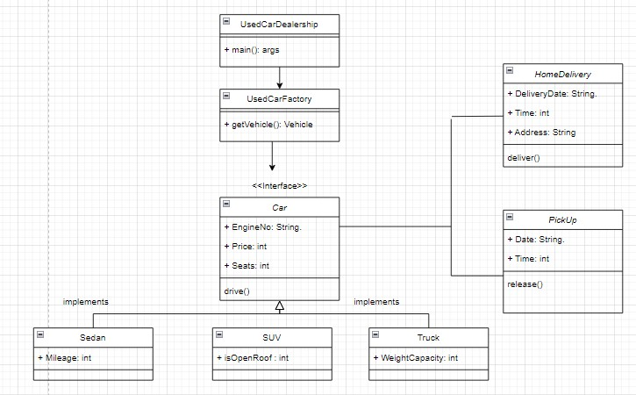
UML CLASS DIAGRAM

Slide 5
UML DESCRIPTION
IN THE ABOVE MENTIONED UML CLASS DIAGRAM, A INTERFACE NAMED ‘CAR’ IS IMPLEMENTED
IT LETS ITS SUBORDINATE CLASSES TO IMPLEMENT IT AND TO ACCESS COMMON FUNCTION WITH DIFFERENT FUNCTIONALITIES CLASS WISE.
MOREOVER, I IMPLEMENTED THREE CONCRETE CLASSES OF DIFFERENT TYPES OF CARS.
THEN, THERE IS A FACTORY CLASS WHICH DECIDES WHICH TYPE OF OBJECT IS TO BE CREATED BASED ON THE DATA RECEIVED BY THE MAIN CLASS.
TWO ADDITIONAL CLASSES IMPLEMENTING THE DELIVERY MODULE HAVE BEEN INCLUDED WHICH ARE CLOSELY WORKING ALONG WITH OTHER CLASSES.

Slide 6
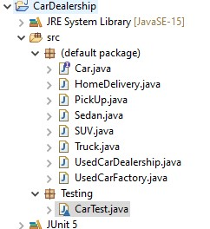
FILE STRUCTURE

Slide 7
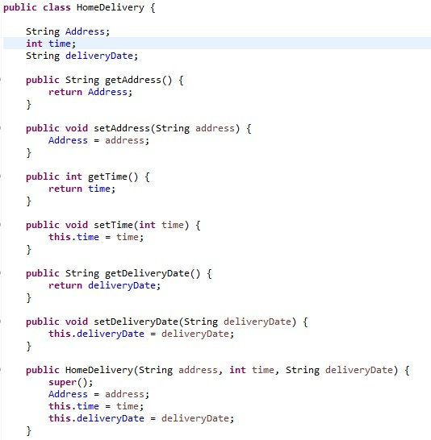
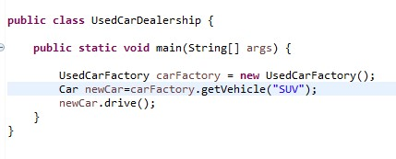
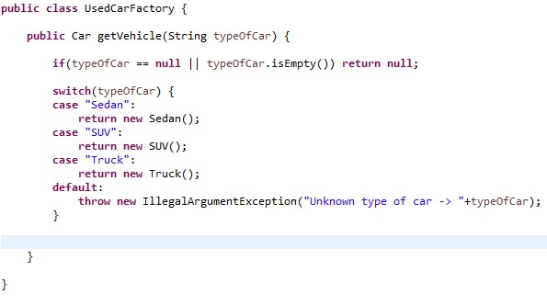
CODE SCREENSHOTS

Slide 8
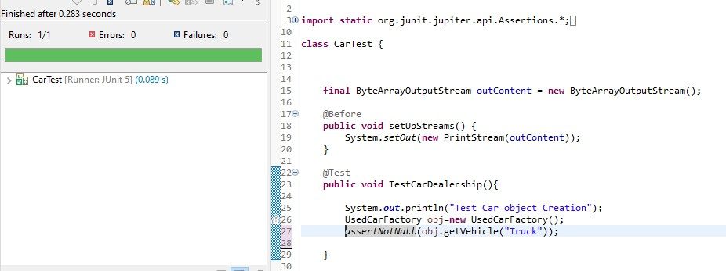
TESTCASE 1

Slide 9
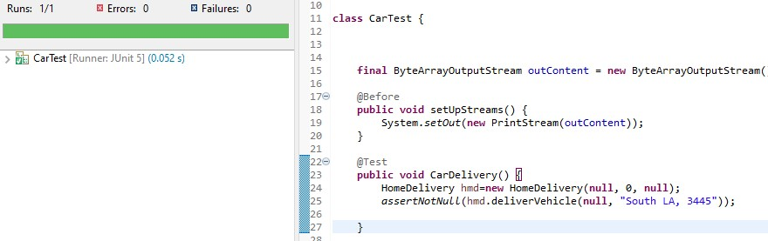
TEST-CASE 2

Slide 10
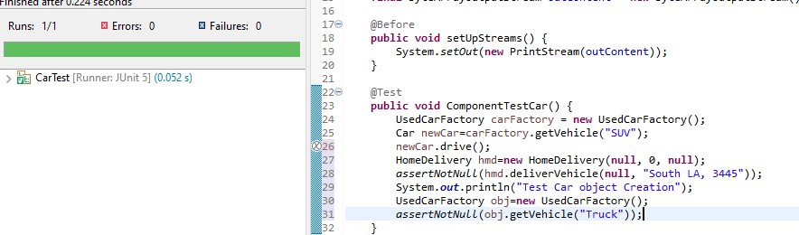
POSITIVE COMPONENT TEST

Slide 11
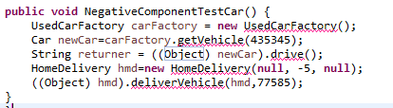
NEGATIVE COMPONENT TEST

